Slide 1





Slide 2
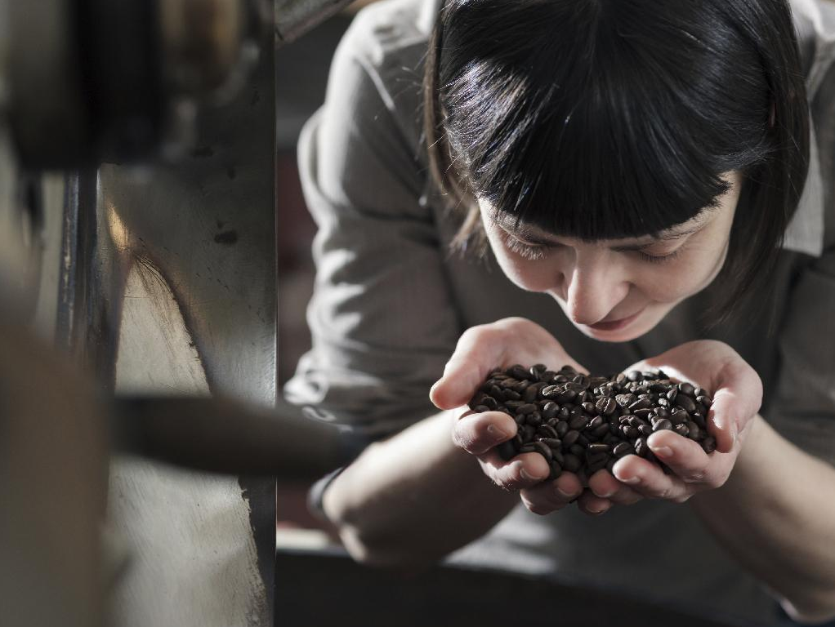

BARISTA FOUNDATION

Slide 3


HOUSEKEEPING
Introductions
Schedule
Restrooms
Please take phone calls outside
Notes:
Trainer Introduction

Slide 4
OBJECTIVES
Recognize differences between Arabica & Robusta
Identify espresso machine and grinder parts
Preparing your station
Notes:
Obj. 1.01, 1.02, 1.03.01

Slide 5
ARABICA vs. ROBUSTA
Arabica
Higher acidity
Higher sweetness
Lighter body
Lower crop yield
Lower caffeine content
Robusta
Lower acidity
More bitterness
Higher crop yield
Hardier plant
Higher caffeine content
Notes:
flavor differences, caffeine levels

Slide 6
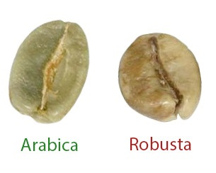
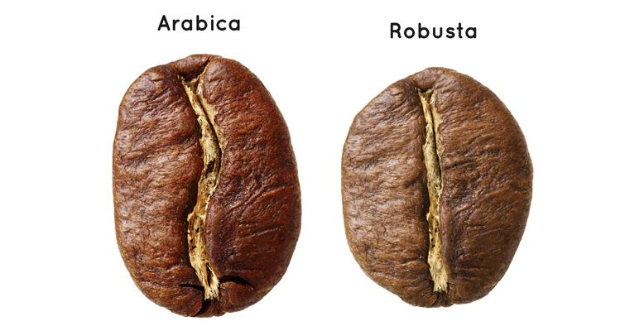
ARABICA vs. ROBUSTA
Notes:
flavor differences, caffeine levels

Slide 7
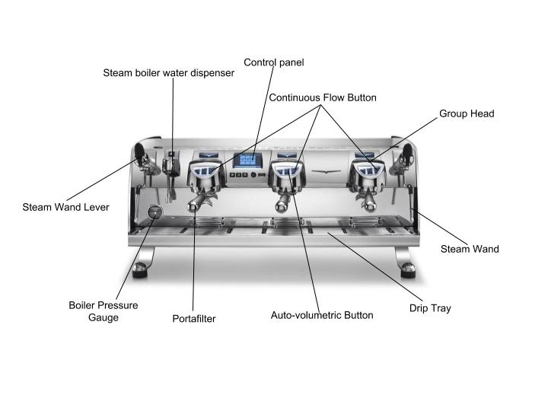
ESPRESSO MACHINES
Notes:
Demonstrate on machines - steamwands, levers/knobs, portafilter, grouphead, screen/gasket, drip tray, gauges, buttons
Mention pump and boiler pressure (see exam, list on handout)
point out and let students gather around

Slide 8
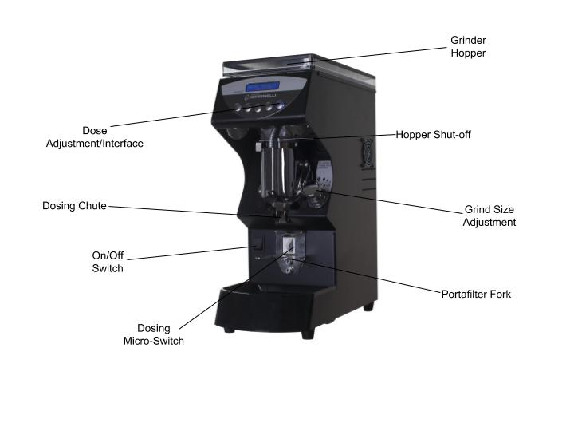
GRINDERS
Doserless/On Demand Grinder
Notes:
Demonstrate on grinders - on/off switch, burrs, hopper, adjustment knob, dosing
point out and let students gather around

Slide 9
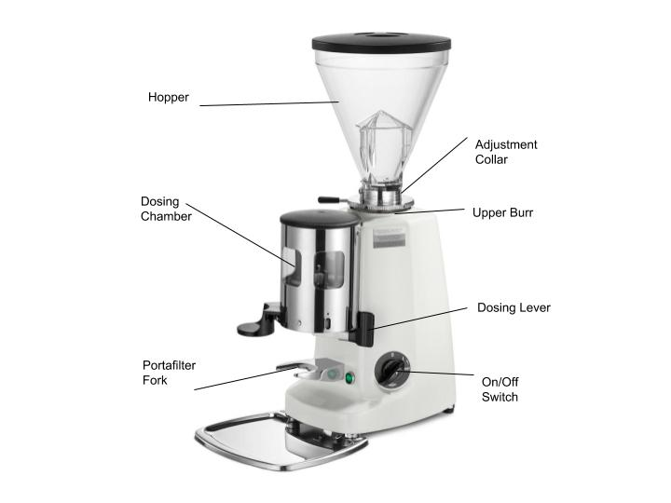
GRINDERS
Doser Grinder

Slide 10
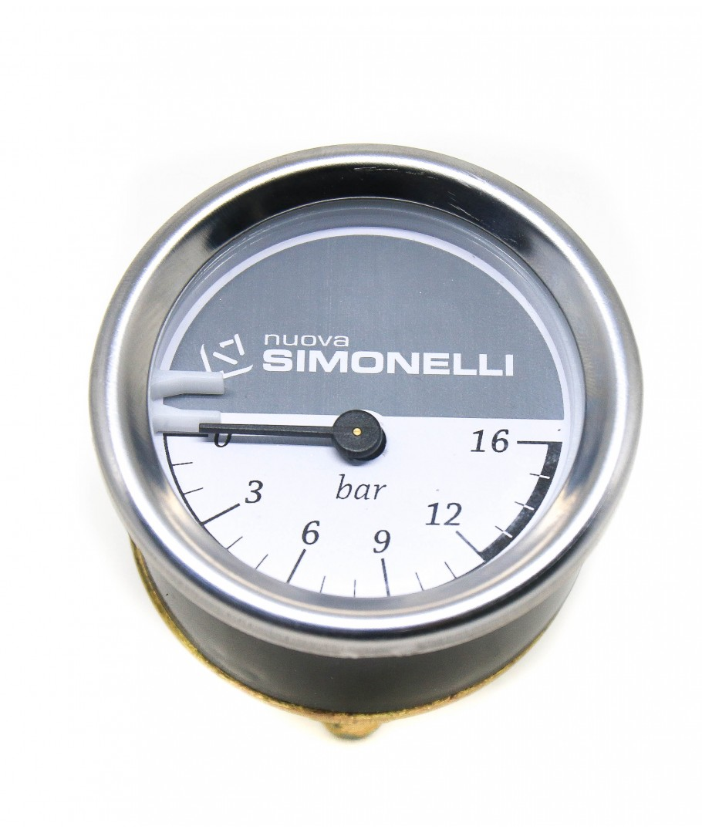
PREPARATION
Checking tools and towels set-up
Check boiler pressure
Warming up groupheads
Notes:
Demonstrate

Slide 11
RECAP/QUESTIONS?
Arabica vs. Robusta
Espresso machine and grinder parts
Preparing your station

Slide 12

OBJECTIVES
Defining Espresso
List the five interdependent elements of brewing espresso
Demonstrate the basics of dosing, distribution and correct tamping technique
Demonstrate the correct steps for preparing espresso to SCA standards

Slide 13
ESPRESSO DEFINITION
Espresso is a drink and method of preparation. It is a beverage made by pumping clean, fresh water at 195-205°F (90.5-96.1° C) and 9-10 Bar of pressure through 14-20 grams of compacted coffee with a particular grind size that it yields 21-50 grams of liquid in 20-30 seconds.
Notes:
Talk about each

Slide 14
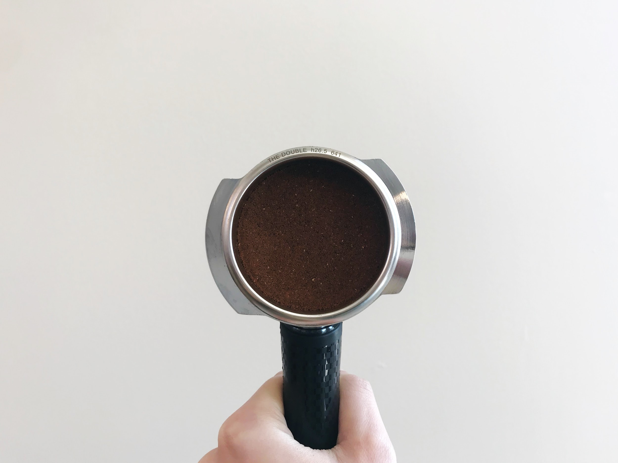
ELEMENTS
Coffee
Water
Machine
Grinder
Barista
Notes:
Talk about each

Slide 15
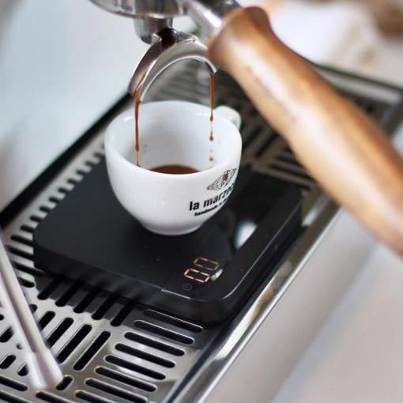
VARIABLES
Dose weight
Grind size
Beverage/Water Volume
Notes:
Describe what variables affect.
Dose Weight: Less = faster flow rate, more = slower flow rate
Grind Size: Smaller grind size = slower flow rate, larger grind size = faster flow rate
Beverage Volume: more water = more extraction, less water = less extraction

Slide 16
PARAMETERS
14 to 20g for double shot
20 to 30 seconds
Brew Ratio of 1:1.5 to 1:2.5 grams in/grams out
Notes:
Example of input to output ratio
Demonstrate, weigh input and output

Slide 17
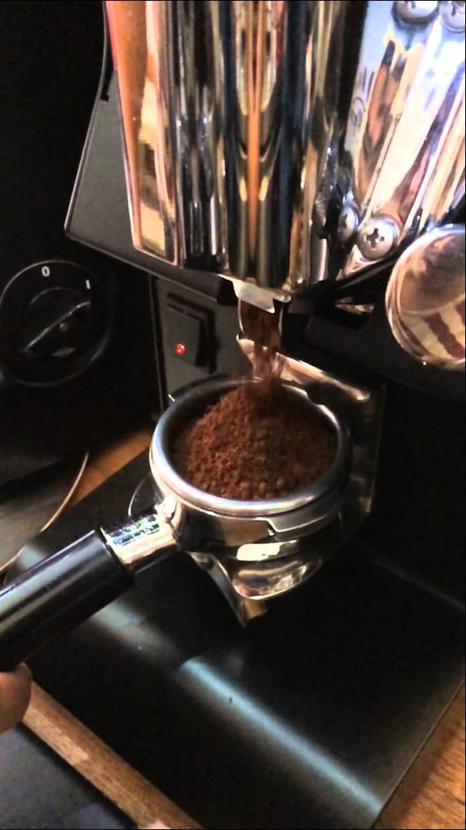
DOSING
Consistent dose weight
Directly affects Brew Ratio
Higher dose weight → longer shot time, lower dose weight → faster shot time
Notes:
Demonstrate ability to calibrate grinder to particular dose, practice distribution technique, discuss channeling and causes
“Channeling will lead to uneven extraction, but most notably underextraction.

Slide 18
GRIND SETTING
Adjust finer - slower time
Adjust coarser - faster time
**Purge grinder 1-2 times after adjustments to remove coffee at previous grind setting**
Notes:
Demonstrate, sand vs. pebbles
Variable to use for adjusting time

Slide 19
BEVERAGE MASS/VOLUME
Higher mass/volume leads to increased extraction
Affects Brew Ratio and Strength
“Strength”:
Concentration of the solution. How much of the beverage is dissolved coffee vs. water molecules
Notes:
Demonstrate, sand vs. pebbles
Variable to use for adjusting time

Slide 20
DISTRIBUTION
Gently tap portafilter to settle, if necessary
Use your index finger to level
Even distribution of coffee across portafilter basket
Goal is to minimize channeling

Slide 21

TAMPING
Correct technique
Arm at 90° angle
Flat and even surface
Consistent pressure
Notes:
Demonstrate
Arm at 90 degree angle

Slide 22
PREPARING ESPRESSO
Remove portafilter from grouphead and flush group
Wipe basket clean and dry
Dose and distribute desired weight
Tamp consistently, level, and ergonomically
Clean loose grounds from edges of portafilter
Insert portafilter into grouphead and start immediately
Observe flow and stop pump appropriately
Serve or use to make espresso based-drink
Remove portafilter and knockout spent grounds
Wipe basket clean and flush group
Return portafilter to grouphead to keep preheated
Notes:
Demonstrate, have shots and parameters dialed in. Everyone practice steps of creating espresso twice. First pull is “proper”, second pull is “under”

Slide 23
RECAP/QUESTIONS?
Five elements of espresso
Variables, parameters, grind setting adjustments
Dosing, Distribution, and Tamping technique
Steps to create espresso

Slide 24
OBJECTIVES
Recognize by sight and taste the differences between under-extraction, over-extraction, and proper extraction
Demonstrate grind calibration and ability to make adjustments
Identify impact of changes in grind size

Slide 25
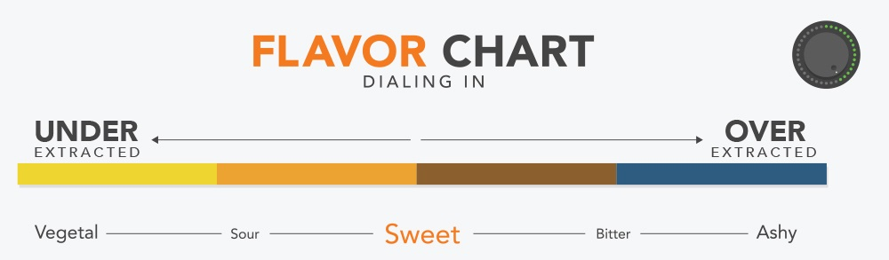
PREPARING ESPRESSO
Activity!
Notes:
Demonstrate, have shots and parameters dialed in. Everyone practice steps of creating espresso twice. First pull is “proper”, second pull is “under”

Slide 26
EXTRACTION
Under-extraction characteristics
Over-extraction characteristics
“Proper” / Acceptable
Notes:
Underextracted is overly sour
Overextracted is overly bitter
properly extracted espresso should taste balanced and sweet

Slide 27
GRIND CHANGE ACTIVITY
Pull initial espresso
Adjust Grind to achieve 5-8 second longer extraction with equivalent output weight (yield)
Taste and compare

Slide 28
SENSORY EXPERIENCE
Taste and describe with help of SCA Flavor Wheel
Pick three descriptors
Aroma/Body/Flavor
Notes:
Let everyone taste and use flavor wheel in Handout
Give three descriptors from the wheel

Slide 29
ROAST DEVELOPMENT
Longer/more developed roasts tend to have more bitterness, less acidity
Less developed/lighter roasts will be brighter, sweeter, more acidic
Notes:
Let everyone taste and use flavor wheel in Handout
Give three descriptors from the wheel

Slide 30
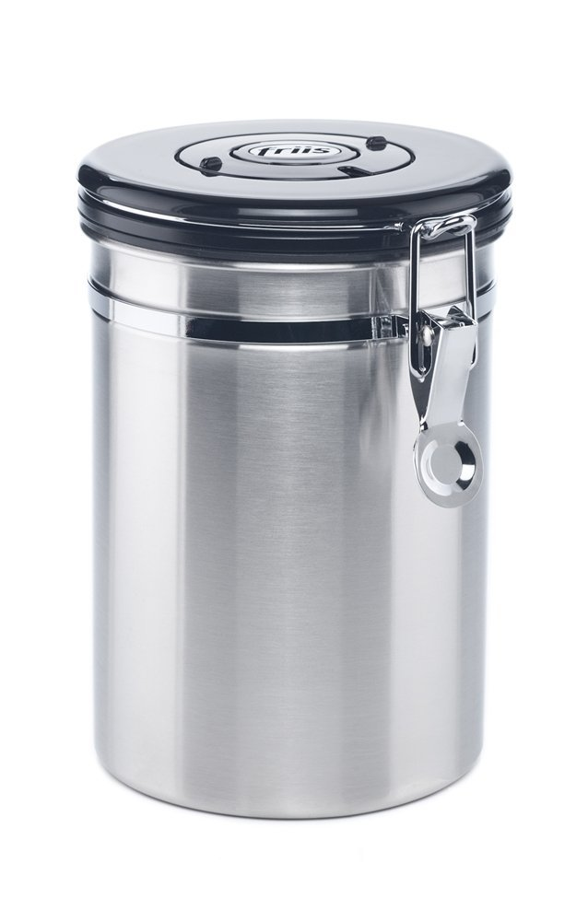
FRESHNESS
Oxygen
Moisture
Temperature
Light
Optimal storage has no oxygen,
is cool, and dry.
Notes:
Coffee should be ground fresh, within 3 minutes of preparation, or sooner for espresso to maintain quality and consistency.

Slide 31
FRESHNESS
Storing Coffee in the Cafe:
Hoppers, lids on during the day
Sealed bags or containers during the night
Use within a month ideally
Notes:
Coffee should be ground fresh, within 3 minutes of preparation, or sooner for espresso to maintain quality and consistency.

Slide 32
RECAP/QUESTIONS?
Extraction and sensory cues
Changing grind size
Effect of grind size on extraction time
Maintaining coffee freshness

Slide 33
LUNCH BREAK
Check Business Hours
Saigon le Vendeur
Casa Colombia

Slide 34
OBJECTIVES
Demonstrate milk steaming technique for correct temperature and texture
Demonstrate hygienic and efficient workflow
Produce a cappuccino

Slide 35
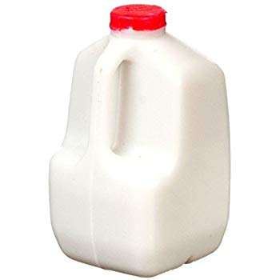
FRESHNESS
Discard past-date/spoiled milk
Rotate milk to use oldest first (FIFO)
Keep milk in the refrigerator when
not in use
Use clean pitchers
Do not re-steam

Slide 36
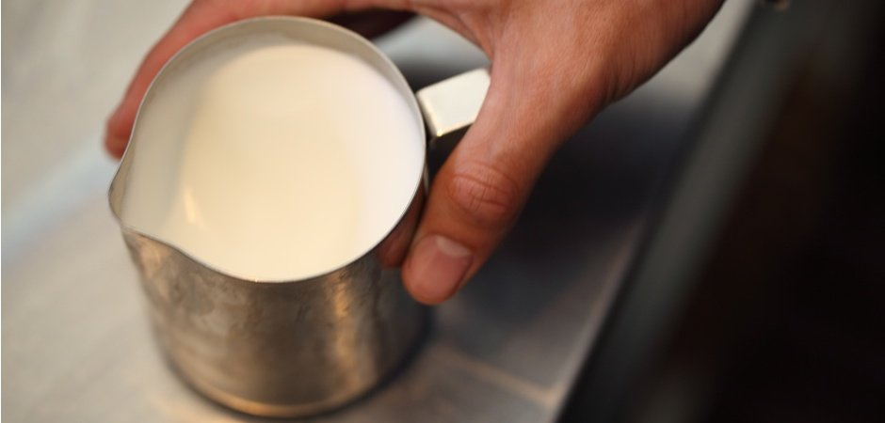
TEXTURE
Dense microfoam
No visible bubbles
Shiny surface
Viscosity of melted marshmallow

Slide 37
STEPS
Purge steam wand
Create whirlpool and aerate gently
Stop aeration when warm
Bring up to temp and stop
Wipe and purge steam wand together
Top Down view of ideal steam wand tip placement in pitcher.

Slide 38
TEMPERATURE
Desired range 131-149℉ (59.4-65℃)
Maximum 158℉(70℃)
Warm(~100℉)
Incorporation
No aeration should be occuring during this stage.
Aeration

Slide 39
“GROOMING”
Swirl and gently tap pitcher on the counter
Cover with your hand to avoid splatter
Notes:
Explain importance, (reincorporates microfoam with liquid milk)

Slide 40
ACTIVITY
Practice milk steaming
Rotate and use different machines
Remember to aerate gently and create microfoam
Notes:
15 minutes (at least 3 tries per person)

Slide 41
PRACTICE
Serve espresso
Prepare a cappuccino
Notes:
Preparing drinks on plates to spec

Slide 42
RECAP/QUESTIONS?
Milk steaming technique, texture, temperature
Hygienic & efficient workflow
Pouring a cappuccino
Notes:
Demonstrate

Slide 43
OBJECTIVES
Define the role of the barista in the coffee industry
List 4 aspects of customer service
Describe the importance of maintenance and cleaning equipment daily

Slide 44
ROLE OF BARISTAS
Prepare beverages correctly
Communicate information to customers
Represent the industry and the work of other coffee professionals (farmer, importer, roaster, etc.)
Notes:
Demonstrate

Slide 45
CUSTOMER SERVICE
Product
Atmosphere
Work environment
Service
Notes:
Quality of product and serving product that people want, comfortable atmosphere, clean/organized work environment, meeting the needs and wants of the customer

Slide 46
BEST PRACTICES
Steam wands soaked
Grinder hoppers wiped out
Purging grinder, brushing away excess
Backflushing espresso machine
Drip trays

Slide 47
BAD PRACTICES
Dirty, musty, earthy, bitter tasting coffee
Increased wear and tear on the equipment
Shortened equipment lifespan (possible break of warranty or equipment malfunction)
Bacterial or fungal growth

Slide 48
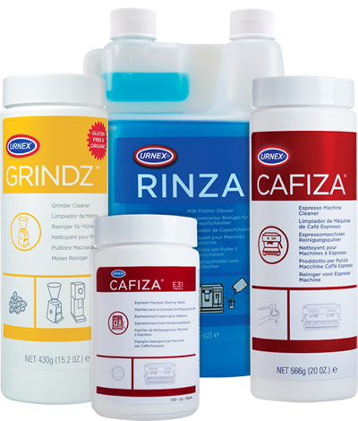
HEALTH & SAFETY
Wash hands
Hold mugs only by the handle or bottom, never the rim
Clean equipment daily
Use proper detergents or solutions
Notes:
Talk about backflushing, cleaning coffee oils off equipment using detergents
What you would expect from a dirty machine: Dirty/musty tasting coffee, reduced machine and equipment lifespan, poor visual cleanliness to customers.

Slide 49
MAINTENANCE
Drinks will taste consistently delicious
Equipment will last longer
Conveys positive image to customers

Slide 50
WATER QUALITY
Water hardness (mineral concentration) important to regulate
Water with high hardness causes scale buildup
Water should be free from taints (chlorine, sulphur)

Slide 51
WORKSPACE
Clean & organized at all times
Minimize waste
Keep tools in appropriate location
“Clean as you go”
Notes:
Demonstrate bar setup (equipment and tool locations, towel placements)

Slide 52
RECAP/QUESTIONS?
Role of baristas in the industry
Customer service
Maintenance & cleaning

Slide 53
SUMMARY
Equipment and parts
Basic elements and steps of preparing espresso
Milk steaming and pouring technique
Best practices for your workplace

Slide 54
REVIEW
Describe the general flavor profile differences in arabica versus robusta

Slide 55
REVIEW
Espresso machine pump pressure should be set around…
Boiler pressure is set approximately...

Slide 56
REVIEW
Explain how changing your dose impacts flow.
Less coffee, then…

Slide 57
REVIEW
Describe channeling, the cause and result

Slide 58
REVIEW
Say you adjust your grind setting to be finer, you can expect your time to…
increase or decrease?

Slide 59
REVIEW
In order to keep coffee fresh, you should avoid…
What are the ideal storage conditions?
Notes:
Moisture, heat, light,

Slide 60
REVIEW
What is the maximum temperature for steamed milk?
Why don’t you go past this temperature?
Notes:
158F

Slide 61
REVIEW
Describe the appearance of “microfoam” milk texture

Slide 62
REVIEW
Describe how to clean the steam wand
Notes:
Soak in cleaning solution 15+ minutes - overnight

Slide 63
REVIEW
How would your espresso taste if you do not clean your machine?
Notes:
Dirty, “overextraction”, poor quality

Slide 64
REVIEW
Explain why you should keep a consistently clean work space.
Notes:
Hygiene, organization, inference of quality and attention to detail

Slide 65
REVIEW
Identify the parts of an espresso grinder (including doser)
Notes:
Use grinder on bar to identify

Slide 66
REVIEW
Identify the parts of an espresso machine
Notes:
Use machine on bar to identify

Slide 67
REVIEW
List and talk about the 4 elements of customer service
Notes:
Product, Atmosphere, Work Environment, Service

Slide 68
REVIEW
Describe the role of baristas in the coffee industry
Notes:
Communicators, Industry Representatives, Experts, prepare beverages

Slide 69
REVIEW
Describe the steps of preparing espresso

Slide 70
REVIEW
Define espresso
Notes:
a method of preparation/extraction (not a degree of roast, grind size, or blend)

Slide 71
REVIEW
Why should you regularly clean your grinder hopper?
Notes:
Keeping it clean of stale/rancid coffee residue, dust, particulates.

Slide 72
REVIEW
List the 5 elements of espresso
Notes:
Coffee, Barista, Machine, Grinder, Water

